Slide 1


Slide 2
Chapter 5
The Relational Data Model and Relational Database Constraints

Slide 3
Chapter Outline
Relational Model Concepts
Relational Model Constraints and Relational Database Schemas
Update Operations and Dealing with Constraint Violations
Chapter 5-<number>

Slide 4
Relational Model Concept
The relational model concepts represents the database as a collection of relations.
Informally, each relation resembles a table of values or, to some extent, a flat file of records.
In the relational model terminology, a row is called a tuple, a column header is called an attribute and the table is called a relation.
The data type describing the types of values that can appear in each column is called a DOMAIN.
Chapter 5-<number>

Slide 5
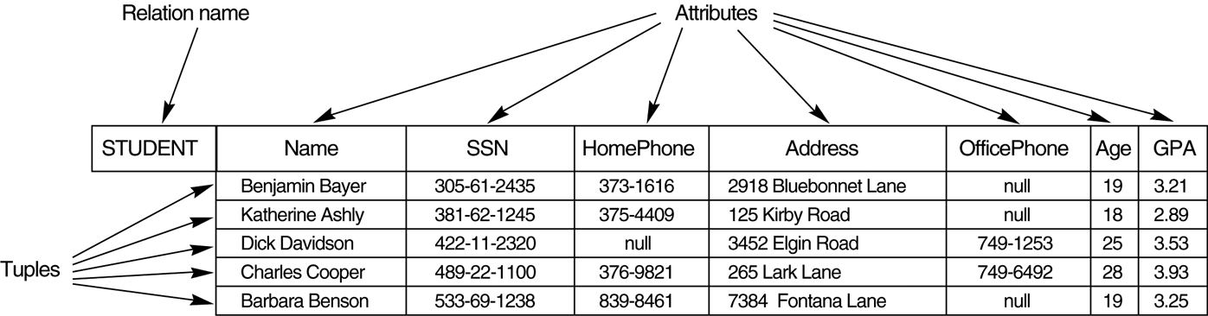
Example - Figure 5.1
Chapter 5-<number>

Slide 6
INFORMAL DEFINITIONS
RELATION: A table of values
  A relation may be thought of as a set of rows.
  A relation may alternately be though of as a set of columns.
  Each row represents a fact that corresponds to a real-world entity or relationship.
  Each row has a value of an item or set of items that uniquely identifies that row in the table.
  Sometimes row-ids or sequential numbers are assigned to identify the rows in the table.
  Each column typically is called by its column name or column header or attribute name.
Chapter 5-<number>

Slide 7
Cont..
A relation schema R, denoted by R(A1, A2, … , An), is made up of a relation name R and a list of attributes, A1, A2, … , An.
Each attribute Ai is the name of a role played by some domain D in the relation schema R. D is called the domain of Ai and is denoted by dom(Ai).
The degree of a relation is the number of attributes n of its relation schema.
Chapter 5-<number>

Slide 8
Cont..
STUDENT(Name, Ssn, Home_phone, Address, Office_phone, Age, Gpa)
Using the data type of each attribute, the definition is sometimes written as:
STUDENT(Name: string, Ssn: string, Home_phone: string, Address: string,
Office_phone: string, Age: integer, Gpa: real)
Chapter 5-<number>

Slide 9
Cont..
Relation (or relation state) r of the relation schema R(A1, A2, … , An), also denoted by r(R), is a set of n-tuples r = {t1, t2, … , tm}.
Each n-tuple t is an ordered list of n values t =<v1, v2, … , vn>, where each value vi, 1 <= i <= n, is an element of dom (Ai) or is a special NULL value.
Chapter 5-<number>

Slide 10
DEFINITION SUMMARY
Informal Terms |  | Formal Terms
Table |  | Relation
Column |  | Attribute/Domain
Row |  | Tuple
Values in a column |  | Domain
Table Definition |  | Schema of a Relation
Chapter 5-<number>

Slide 11
CHARACTERISTICS OF RELATIONS
Ordering of tuples in a relation r(R): The tuples are not considered to be ordered, even though they appear to be in the tabular form.
Ordering of attributes in a relation schema R (and of values within each tuple): We will consider the attributes in R(A₁, A₂, ..., A_{n}) and the values in t=<v₁, v₂, ..., v_{n}> to be ordered .
(However, a more general alternative definition of relation does not require this ordering).
Values in a tuple: All values are considered atomic (indivisible). A special null value is used to represent values that are unknown or inapplicable to certain tuples.
Chapter 5-<number>

Slide 12
Relational Integrity Constraints
Constraints are conditions that must hold on all valid relation instances. There are three main types of constraints:
1 Domain Constraint
  2.Key constraints
  3.Entity integrity constraints
  4.Referential integrity constraints
Chapter 5-<number>

Slide 13
Domain Constraint
Domain constraints specify that within each tuple, the value of each attribute A must be an atomic value from the domain dom(A).
The data types associated with domains typically include standard numeric data types for integers (such as short integer, integer, and long integer) and real numbers (float and double-precision float). Characters, Booleans, fixed-length strings, and variable-length strings are also available, as are date, time, timestamp, and other special data types.
Chapter 5-<number>

Slide 14
Key Constraints
Superkey of R: A set of attributes SK of R such that no two tuples in any valid relation instance r(R) will have the same value for SK. That is, for any distinct tuples t1 and t2 in r(R), t1[SK] ≠ t2[SK].
Key of R: A "minimal" superkey; that is, a superkey K such that removal of any attribute from K results in a set of attributes that is not a superkey.
  Example: The CAR relation schema:
  CAR(State, Reg#, SerialNo, Make, Model, Year)
  has two keys Key1 = {State, Reg#}, Key2 = {SerialNo}, which are also superkeys. {SerialNo, Make} is a superkey but not a key.
If a relation has several candidate keys, one is chosen arbitrarily to be the primary key. The primary key attributes are underlined.
Chapter 5-<number>

Slide 15
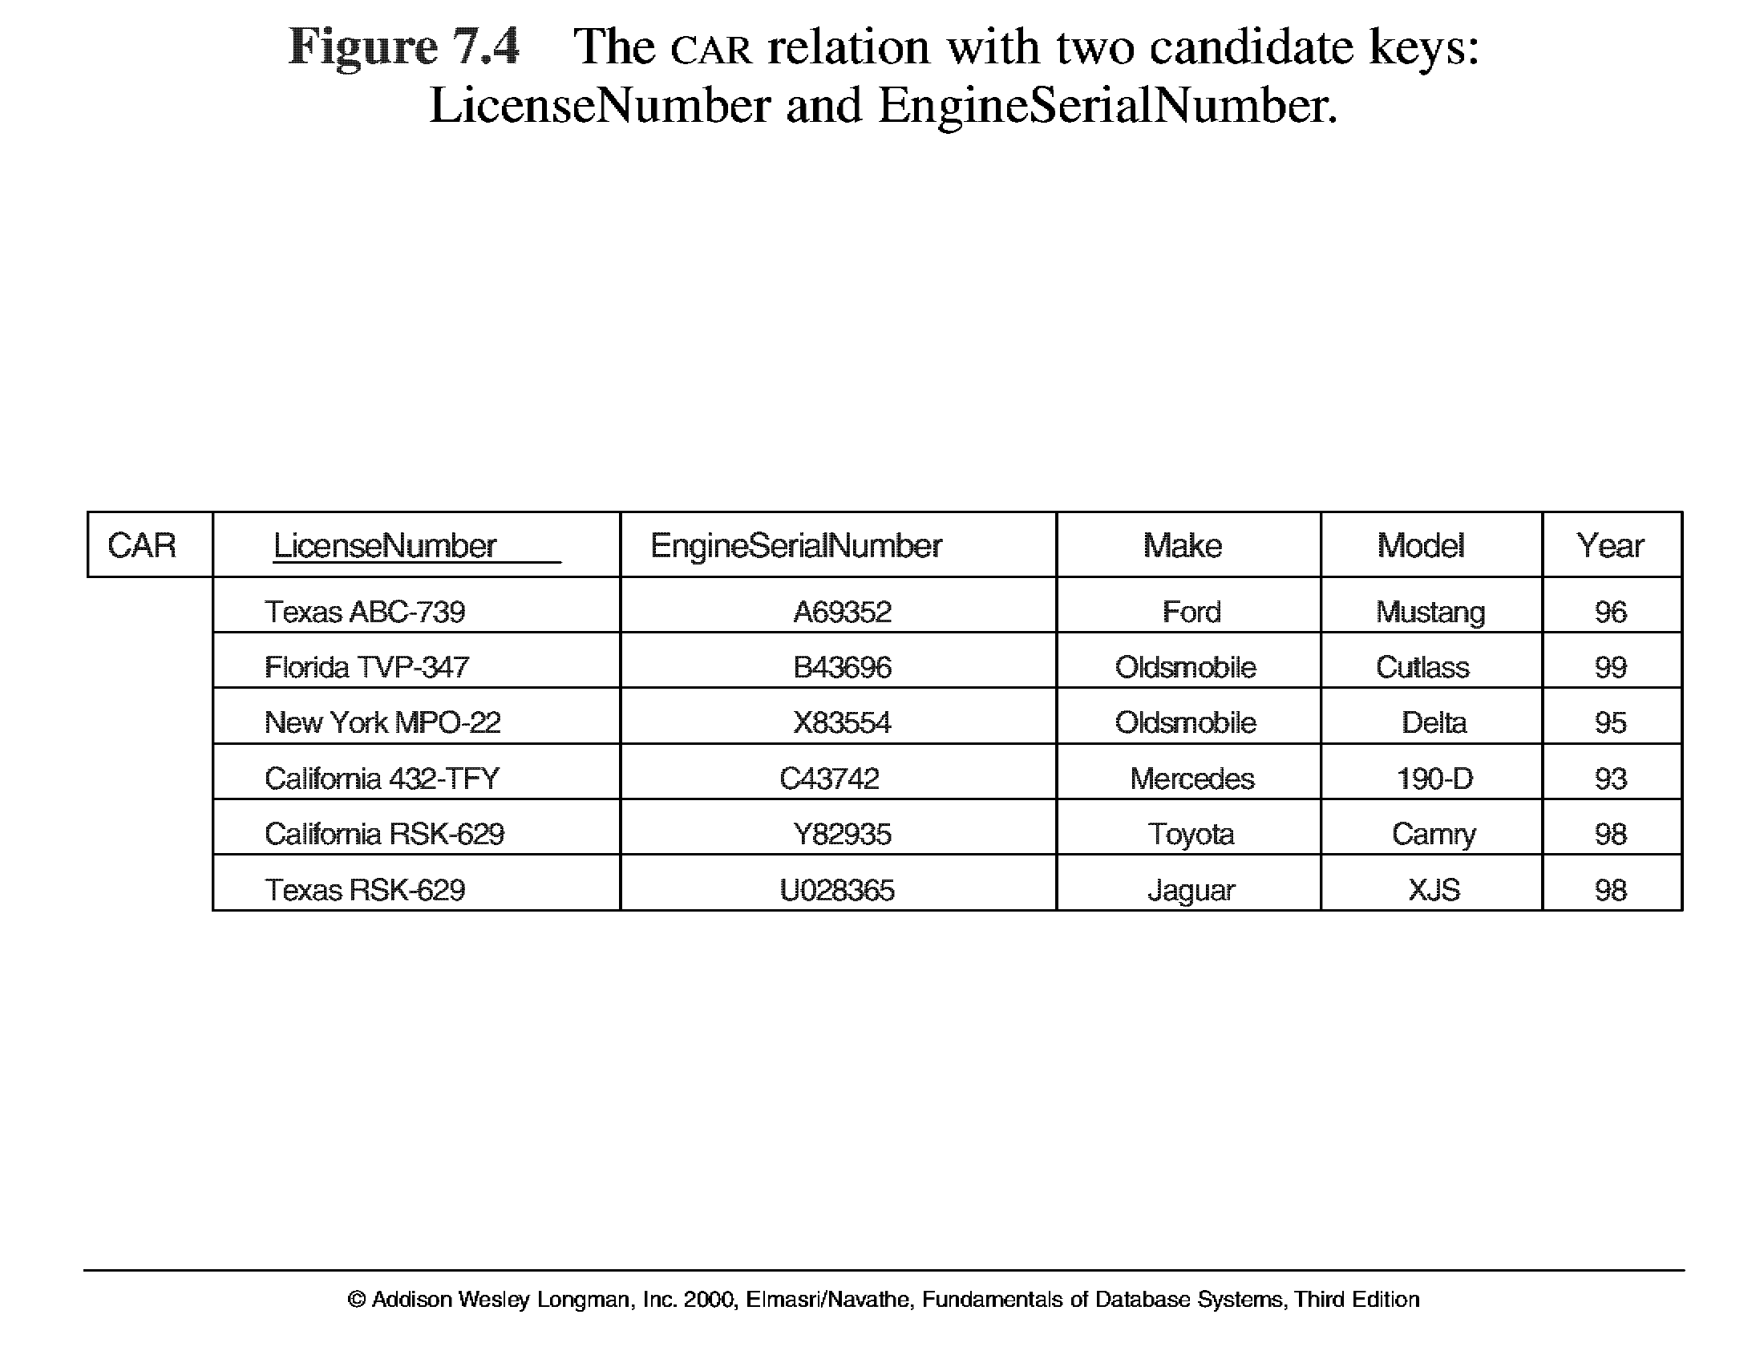
Key Constraints
5.4
Chapter 5-<number>

Slide 16
Entity Integrity
Relational Database Schema: A set S of relation schemas that belong to the same database. S is the name of the database.
S = {R₁, R₂, ..., R_{n}}
Entity Integrity: The primary key attributes PK of each relation schema R in S cannot have null values in any tuple of r(R). This is because primary key values are used to identify the individual tuples.
t[PK] ≠ null for any tuple t in r(R)
Note: Other attributes of R may be similarly constrained to disallow null values, even though they are not members of the primary key.
Chapter 5-<number>

Slide 17
Referential Integrity
The referential integrity constraint is specified between two relations and is used to maintain the consistency among tuples in the two relations.
Informally, the referential integrity constraint states that a tuple in one relation that refers to another relation must refer to an existing tuple in that relation.
To define referential integrity more formally, first we define the concept of a foreign key. The conditions for a foreign key, given below, specify a referential integrity constraint between the two relation schemas R1 and R2.
A set of attributes FK in relation schema R1 is a foreign key of R1 that references relation R2 if it satisfies the
following rules:
Chapter 5-<number>

Slide 18
Cont..
1. The attributes in FK have the same domain(s) as the primary key attributes PK of R2; the attributes FK are said to reference or refer to the relation R2.
2. A value of FK in a tuple t1 of the current state r1(R1) either occurs as a value of PK for some tuple t2 in the current state r2(R2) or is NULL. In the former case, we have t1[FK] = t2[PK], and we say that the tuple t1 references or refers to the tuple t2.
Chapter 5-<number>

Slide 19
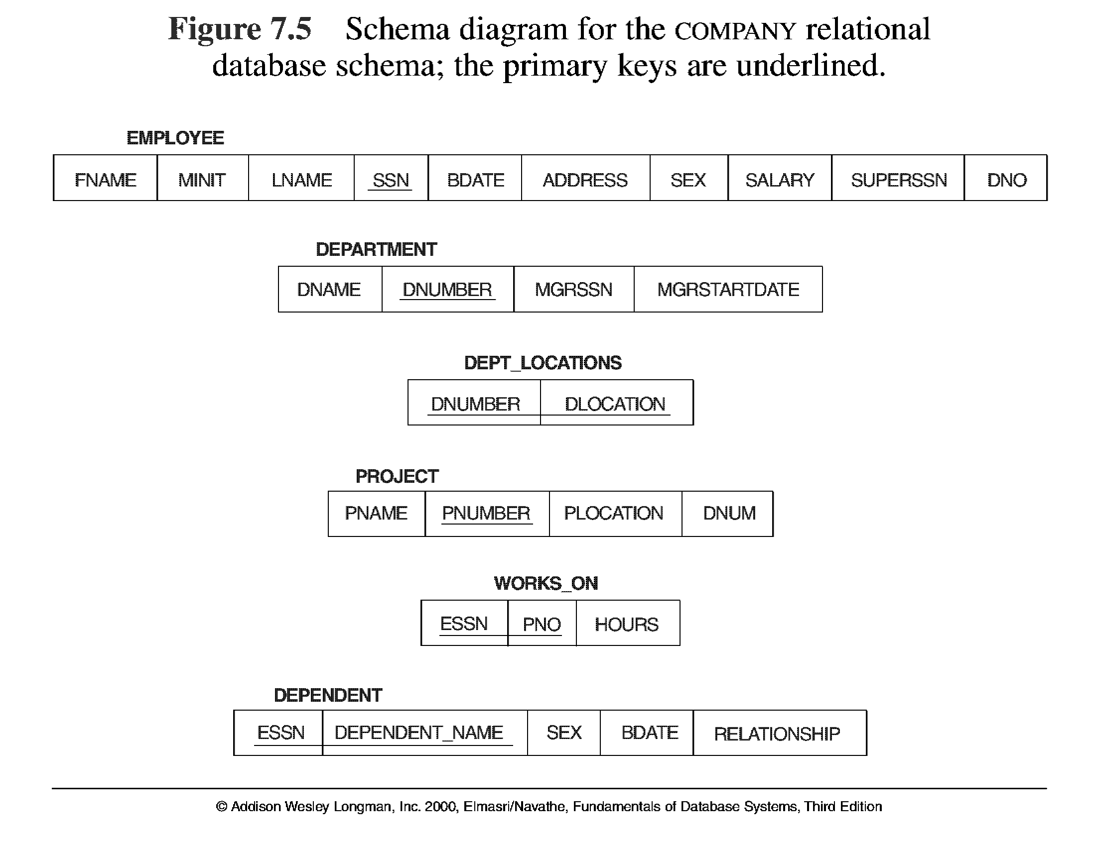
5.5
Chapter 5-<number>

Slide 20
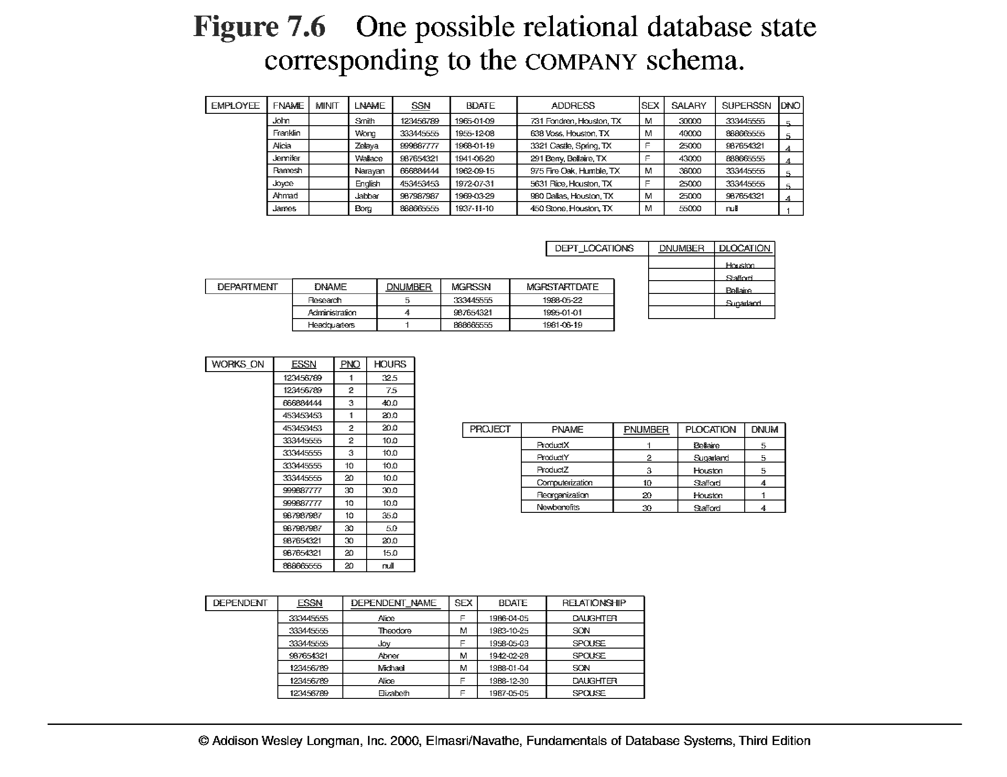
5.6
Chapter 5-<number>

Slide 21
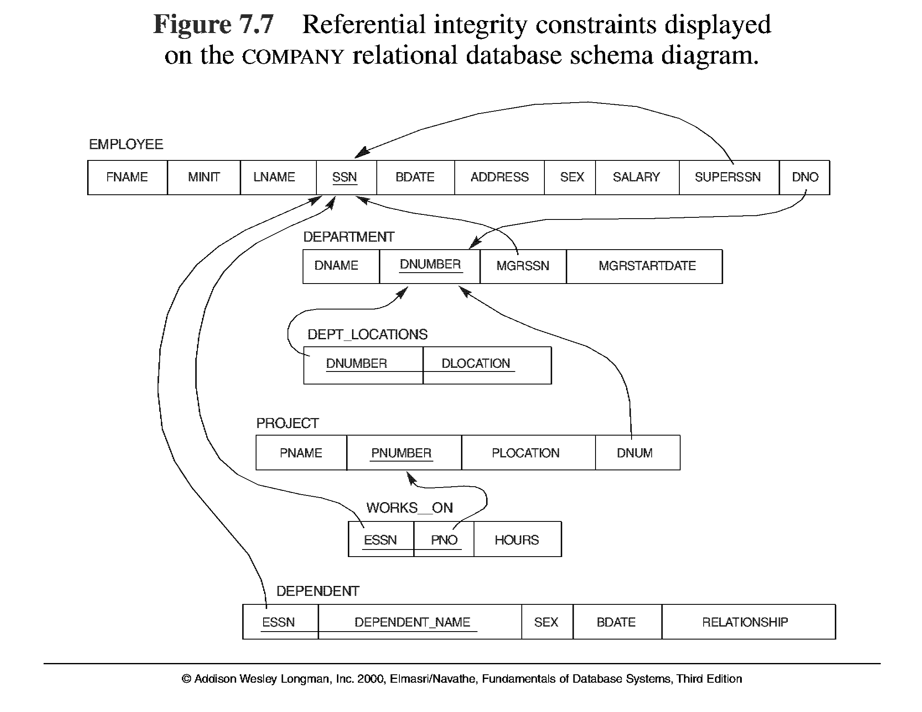
5.7
Chapter 5-<number>

Slide 22
Update Operations on Relations and dealing with constraint violation
INSERT a tuple. – All the four constraint
DELETE a tuple. – Referencial integrity constraint
MODIFY a tuple. –All the four constraint
Integrity constraints should not be violated by the update operations.
Several update operations may have to be grouped together.
Updates may propagate to cause other updates automatically. This may be necessary to maintain integrity constraints.
Chapter 5-<number>

Slide 23
Insert operation
Insert <‘Cecilia’, ‘F’, ‘Kolonsky’, NULL, ‘1960-04-05’, ‘6357 Windy Lane, Katy, TX’, F, 28000, NULL, 4> into EMPLOYEE.
Result: This insertion violates the entity integrity constraint (NULL for the
primary key Ssn), so it is rejected.
Insert <‘Alicia’, ‘J’, ‘Zelaya’, ‘999887777’, ‘1960-04-05’, ‘6357 Windy Lane, Katy, TX’, F, 28000, ‘987654321’, 4> into EMPLOYEE.
Result: This insertion violates the key constraint because another tuple with the same Ssn value already exists in the EMPLOYEE relation, and so it is rejected.
Insert <‘Cecilia’, ‘F’, ‘Kolonsky’, ‘677678989’, ‘1960-04-05’, ‘6357 Windswept, Katy, TX’, F, 28000, ‘987654321’, 7> into EMPLOYEE.
Result: This insertion violates the referential integrity constraint specified on Dno in EMPLOYEE because no corresponding referenced tuple exists in DEPARTMENT with Dnumber = 7.
Chapter 5-<number>

Slide 24
Update Operations on Relations
In case of integrity violation, several actions can be taken:
  Cancel the operation that causes the violation (REJECT option)
  Perform the operation but inform the user of the violation
  Trigger additional updates so the violation is corrected (CASCADE option, SET NULL option)
  Execute a user-specified error-correction routine
Chapter 5-<number>

